Slide 1
MIS-637 Final Project Predicting Prices for Smart Stay Reservation - Airbnb
Prepared by: Arun Krishnasamy
Student Id: 10455045
Professor: daneshmand Mahmoud

Slide 2
Contents
Problem Statement ( Business Understanding )
Data Preprocessing & Data Quality ( Data Preparation )
Data Insights ( Insight Analysis & Visualization )
Conclusion and Analysis ( Evaluation & Deployment )
References
Relevant Data ( Data Understanding )
Methodologies/Algorithm’s ( Modelling & Execution )

Slide 3

Problem statement – Business understanding
A major issue in planning a holiday trip to other city/country is finding a cheap accommodation online and save prices on reservation. Airbnb is a peer-to-peer online marketplace for arranging homestay solutions which allows users to rent and book residential properties. This project provides insights to users on what are the principal factors majorly influences the price of listings in Airbnb and how to effectively use the insights to their own situation.

Slide 4
Problem statement – Business understanding
This project focus on providing insights to following contexts
To provide insights to customers who wishes to rent listings from Airbnb on how to choose best listing for cheap price and save money
To provide insights to renters who post their place on Airbnb for rent on how much renting price to fix for their listings and yearn more profits.

Slide 5
Relevant data – data understanding
The Dataset details the listing activity of homestays in Washington state’s largest metropolitan city “Seattle” which is obtained from http://insideairbnb.com/get-the-data.html.
The following data files are used to determine insights.
Calendar - contains date availability, listing price and ID.
Listing - contains all details of listing such as ID, transit, address, location, availability, reviews.
Reviews - contains user id, reviews and comments.

Slide 6
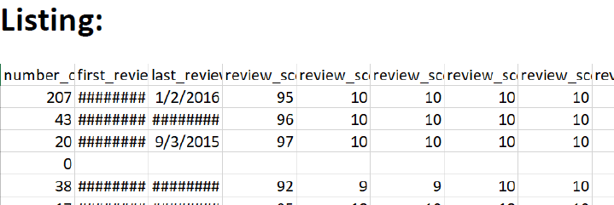
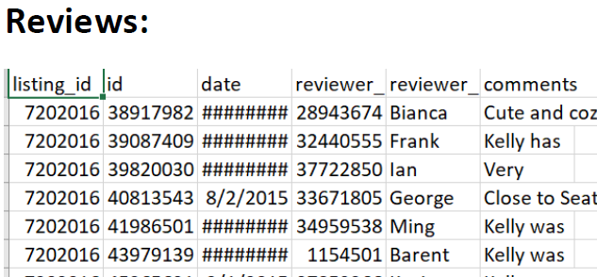
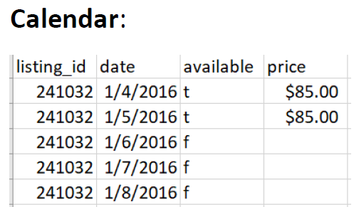
Relevant data – data understanding
The current process in airbnb.com determines its listing price based on factors like number of nights, cleaning fee, number of guests, extra guest and VAT-taxes and local taxes as mentioned in their website - “Airbnb price determination”.
This analysis will rather focus on data’s like reservation season (time), amenities provided, reviews and location of the listing (based on its neighborhood) and understand its significance on how it will affect the listing price and provide insights to the customers.

Slide 7
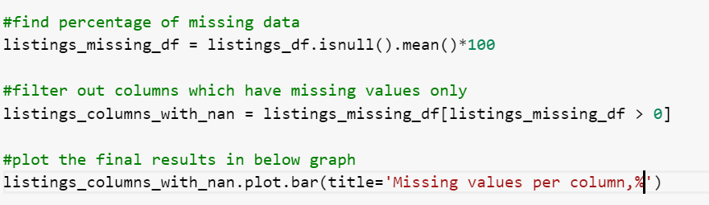
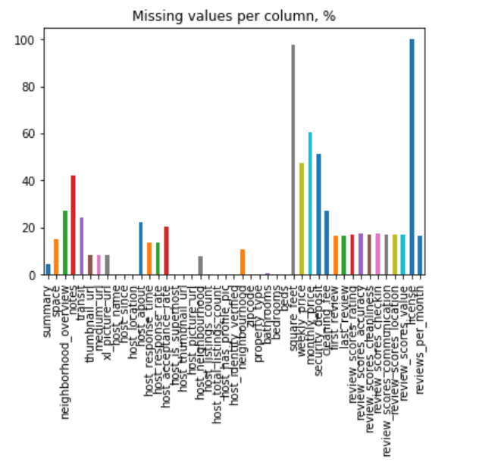
Data Preprocessing & Data Quality - Data Preparation
Listing data set analysis:
Perform missing data analysis on listing dataset to figure out the percentage of missing data
Based on the missing data analysis on we find out that various fields in the listing dataset like weekly price, Monthly price, square feet, security deposit, license have more than 50% of the data missing in the dataset
These missing data has least significance in our analysis, hence these datasets are ignored/removed in further processing during data cleaning to avoid overfitting the training model.

Slide 8
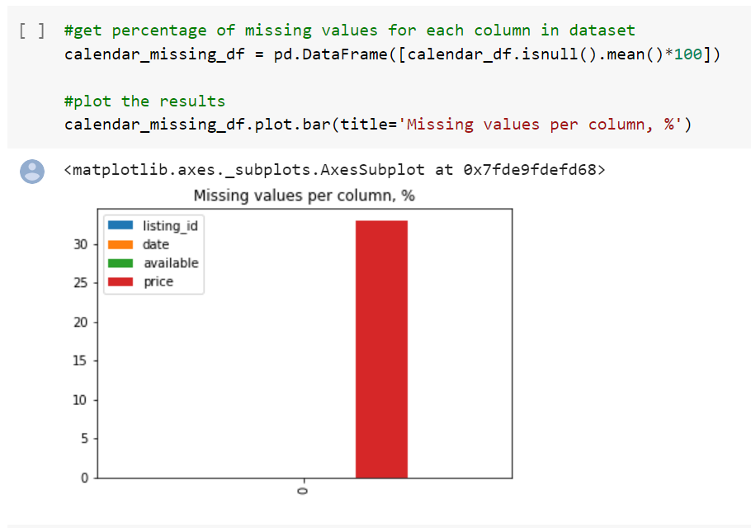
Data Preprocessing & Data Quality - Data Preparation
Calendar data set analysis:
Perform missing data analysis on calendar dataset to figure out the percentage of missing data
Based on the missing data analysis on we find out that price data is missing for around 30% of the listing data provided in the dataset

Slide 9
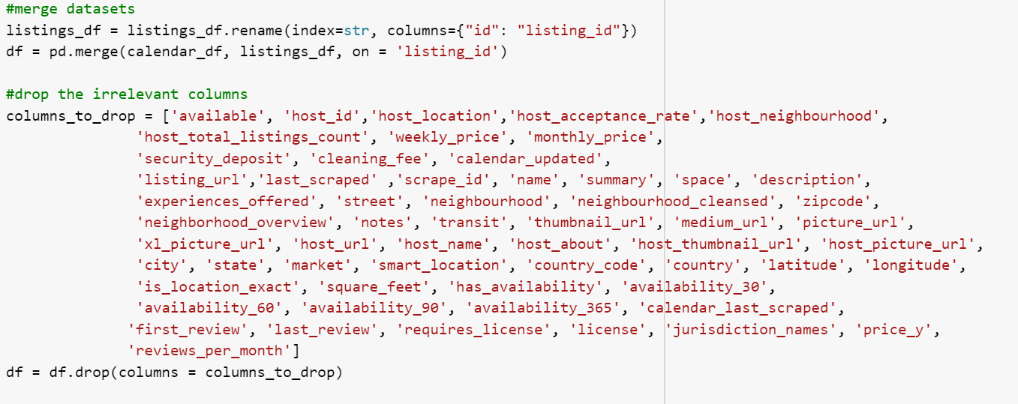
Data Preprocessing & Data Quality - Data Preparation
Data Cleaning & pre-processing:
Various data preprocessing and data cleaning techniques are used, starting with merging dataset into single using listing identifier
And remove extraneous data’s which are not required
Convert date and price value into number value.
Split columns containing list into different related fields
Replace missing values with other values like mean value, mode value or dummy values like 0’s and 1’s

Slide 10
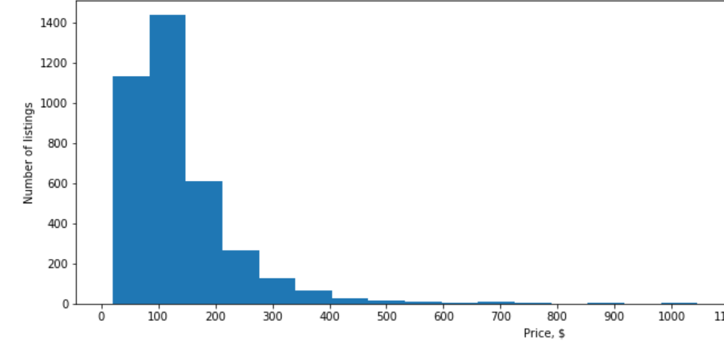
Data Insights – Insight Analysis & Visualization
Based on the cleaned data we conduct various insight analysis on it to determine various factors directly and indirectly affects the price of the listing in airbnb.com
Listing/Price histogram:

Slide 11
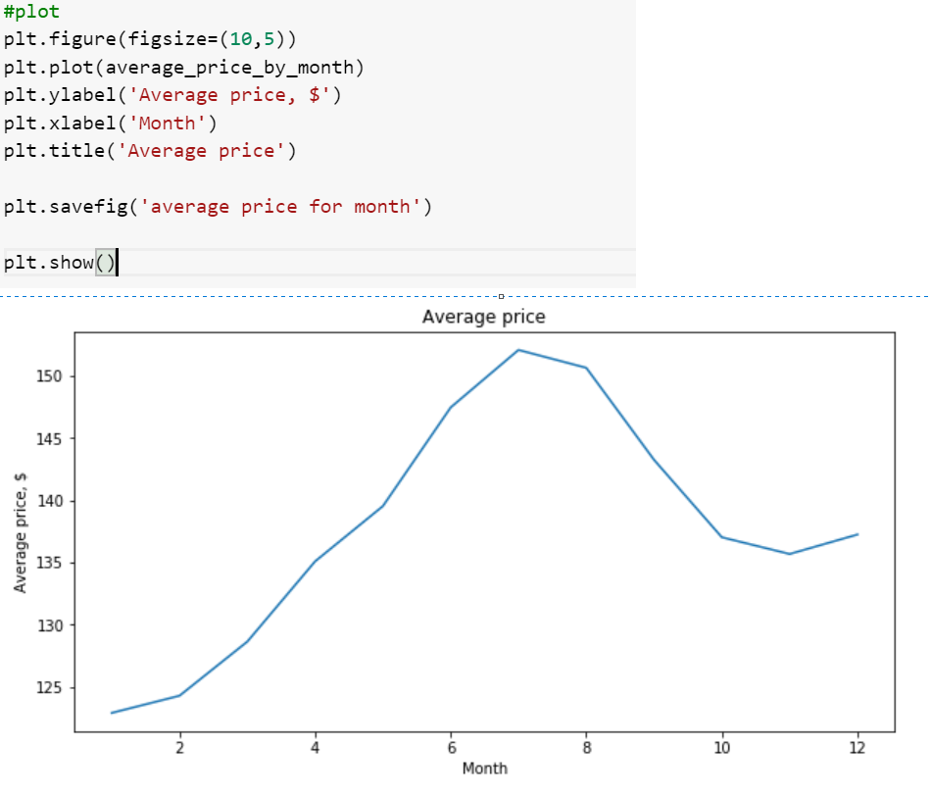
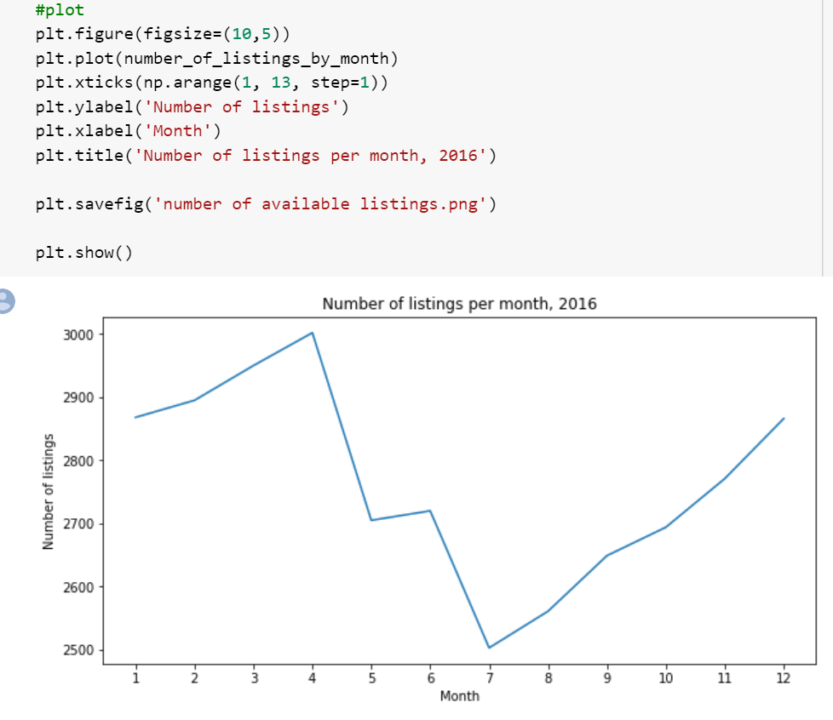
Data Insights – Insight Analysis & Visualization
Season analysis is made to figure out which months in the year are busiest and which month in the year are not.
Comparing season analysis with the price analysis chart it is also revealed that the average price of the listing is high in peak season like in the months 6 to 9
Hence it can be concurred that listing demand is directly proportional to setting listing price.

Slide 12
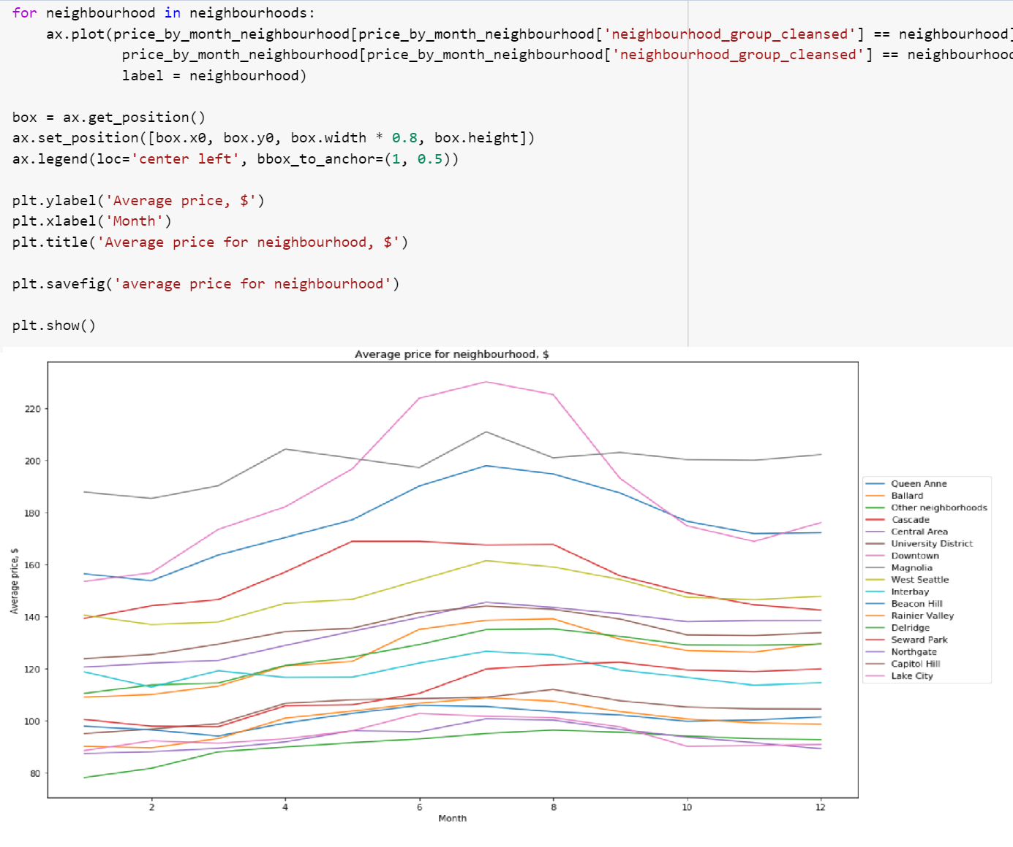
Data Insights – Insight Analysis & Visualization
Listing geography analysis:
Analysis made on determining prices based on the listing location to figure out the cheap priced locations and the costliest one

Slide 13
Methodologies/Algorithm’s – Modelling & Execution
Random Forest regressor:
We are going to apply machine learning techniques test and train dataset to figure out which feature/field in the dataset highly influence the price value of the listing.
RF-Random forest technique is used since its typically provide high accuracy because unlike simple decision tree algorithm, in random forest algorithm the process of finding root node and splitting feature node happens randomly and it is capable of handling missing values.
The process involved in RF methods are
Use train_test_split() function to prepare train and test data sets
Train Random forest model using RandomForestRegressor() function
Post that fit the model on training data using fit() function
Calculate scores for the model
Plot the corresponding graph for the model predicted against its feature importance's along with their inter-tree variability.

Slide 14
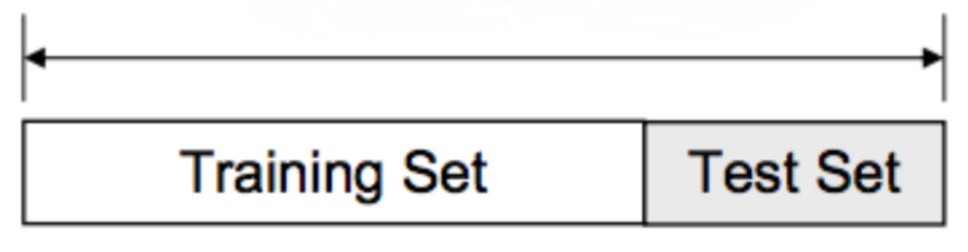
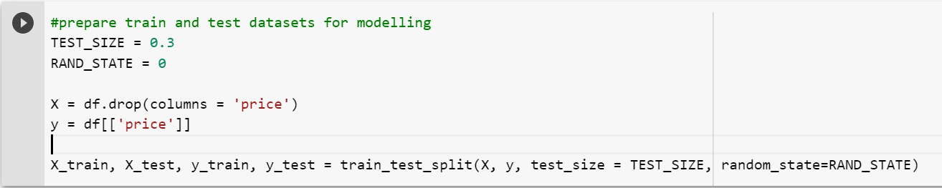
Methodologies/Algorithm’s - Modelling & Execution
Random Forest regressor:
prepare train and test data sets:
The train_test_split() function is used to make the split of dataset into two – training and testing dataset, the value is represented from 0 to 1 which denotes corresponding split percentage. Ideally the training set percentage should be considerably higher than the testing data set. Here we have set the test size as 0.3 ~ 30%. Once the Test size parameter is entered in the function it automatically sets the training set size ( 1 – test size), here its (1 – 0.3) = 0.7 (70%).

Slide 15
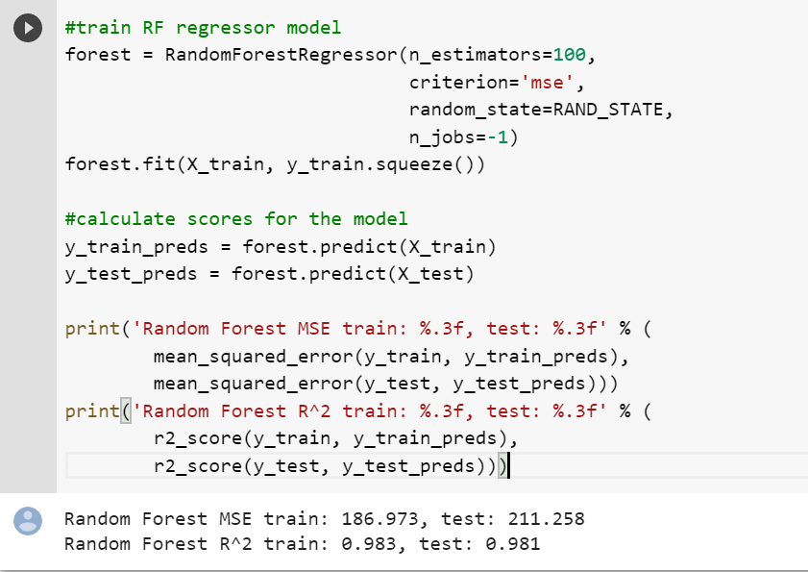
Methodologies/Algorithm’s - Modelling & Execution
Random Forest regressor:
Train, fit and calculate score using Random forest: The model is trained using randomforestregressor() function and the model is fitted into training data using fit function and “Mean Squared error” score and “R square” score is calculated for both training and testing data set
 | Training Data | Test Data
Mean Squared Error | 186.97 | 211.25
R Square | 0.983 | 0.981

Slide 16
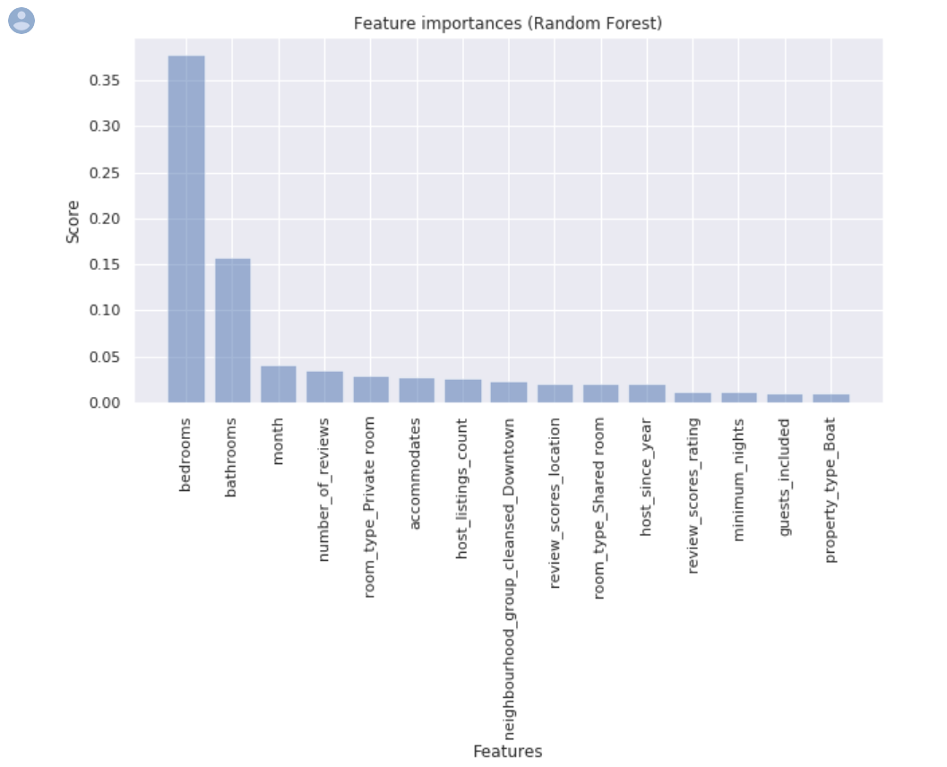
Methodologies/Algorithm’s - Modelling & Execution
Random Forest regressor:
Random forest feature importance: The feature importance of the forest is calculated to evaluate the important features in the dataset which highly influence the result score which is directly influence the price of the listing
Based on this analysis a conclusion can be made on which features directly influences the price

Slide 17
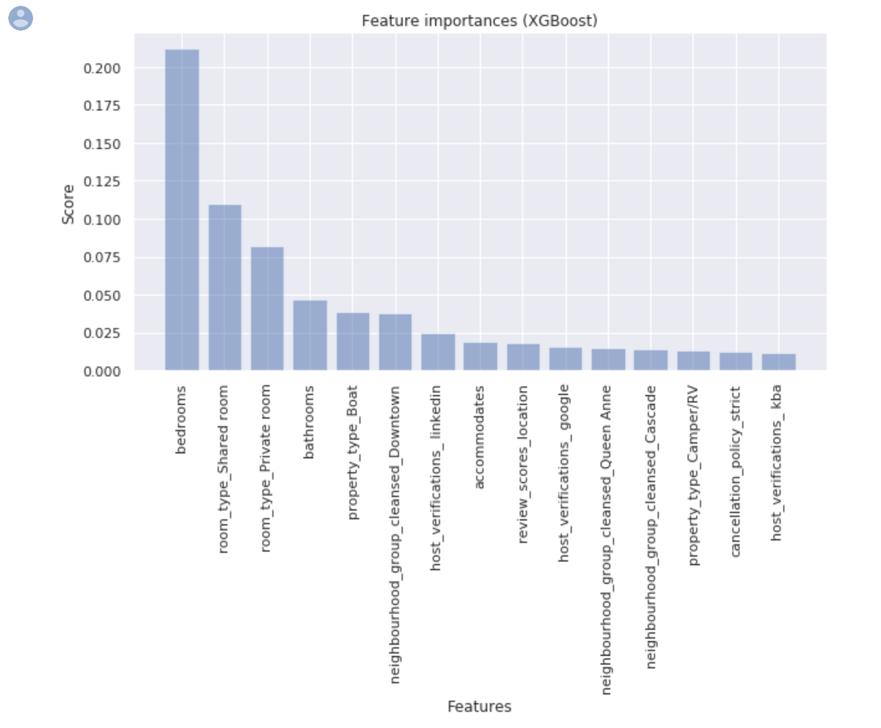
Methodologies/Algorithm’s - Modelling & Execution
Gradient Boost regressor:
Similar to random forest regressor method XG Boost method is implemented to analyze if the method can provide better results and provide better insights to the users based on the results from both the technique
This technique if better tuned can provide better results than random forest
 | Training Data | Test Data
Mean Squared Error | 885.56 | 890.05
R Square | 0.92 | 0.918

Slide 18
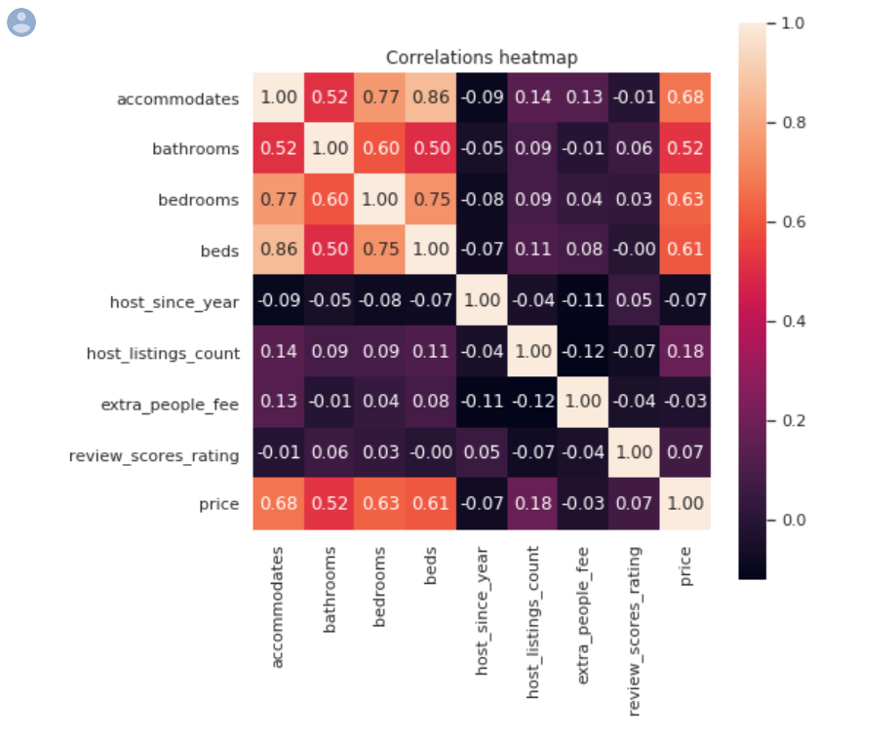
Conclusion and Analysis - Evaluation & Deployment
While analyzing the results from both models we concur that certain factors have greater influence on the listing price. Features like bedroom, bathroom, room type bathroom type has greater influence on price factors
From correlation heatmap we can also figure out that factors like reviews, beds provided, review count could also influence the price.
Also we deduce that factors like host since year, extra people fee plays lesser role in determining the price

Slide 19
Conclusion and Analysis - Evaluation & Deployment
Procured Solutions - Insights To Customers:
Based on analysis when planning for trip and to book cheap listings the customers should consider the month of travelling (season of travelling) and summer months (6to9) are costliest.
The analysis provides insights to customers with neighborhood with cheap prices to rent listings
Based on our machine learning model the customers are suggested to look out for features like number of bedrooms and bathrooms and extra people to determine cheap price.
For example. The customer can look for listings with less bedrooms and bathrooms for cheap price

Slide 20
Conclusion and Analysis - Evaluation & Deployment
Procured Solutions - Insights To Renters :
Based on our analysis the renters can fix high prices in months in peak seasons to make use of high demand and earn more money
Also, if the renters are provided with suggestion to tweak the prices based on their listing neighborhood to get maximum benefit
Our machine learning insights suggests that if the listing has more bedrooms, bathrooms, and if it can accommodate more people in the house, then the listing can be posted with high markup prices in the website
Also, renters should work hard to earn more reviews to increase their credibility and earn more money

Slide 21
References
Data Source:
http://insideairbnb.com/get-the-data.html
Airbnb price determination factors:
https://www.airbnb.com/help/article/125/how-is-the-price-determined-for-my-reservation?locale=en
Development Reference:
https://en.wikipedia.org/wiki/Random_forest
https://towardsdatascience.com/train-test-split-and-cross-validation-in-python-80b61beca4b6
https://xgboost.readthedocs.io/en/latest/python/python_api.html
https://scikit-learn.org/stable/modules/generated/sklearn.ensemble.RandomForestClassifier.html

Slide 22
THANK YOU

